Slide 1
AI IN FINANCIAL SERVICES
DEFECT DETECTION FOR LAPTOPS
Industry Mentor
Manu Sharma
Hewlett Packard Enterprise(HPE)
Gayathri R 22i218
Vinithaa P 22z273
Kiruthika Sermadurai 22z336
Sanjitha R 22z259
Durga G 22z321
Academic Mentor
Dr.Suriya S
CSE Department
PSG College of Technology

Slide 2
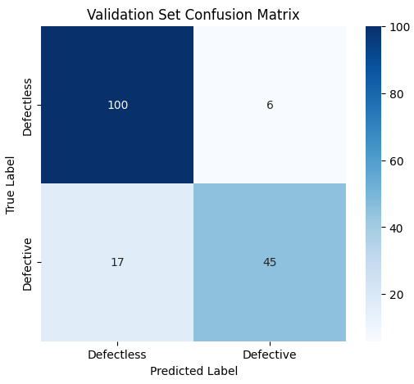
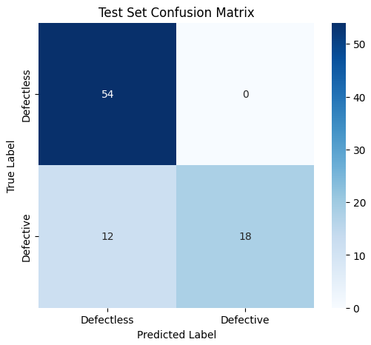
MobileNet V2 - Confusion Matrix

Slide 3

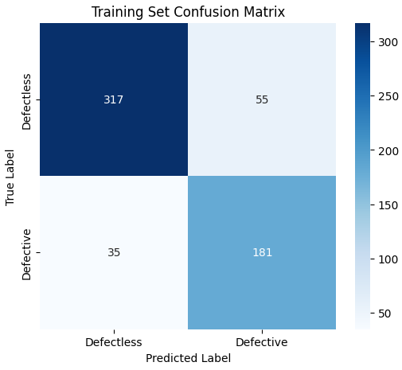
MobileNet V2 - Confusion Matrix

Slide 4
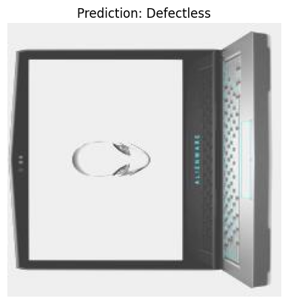
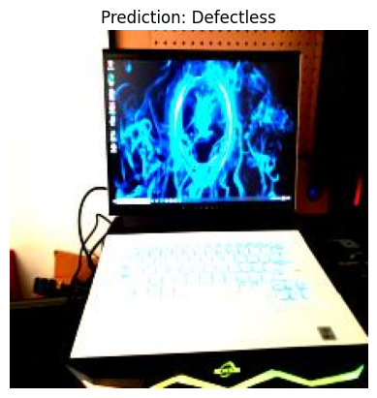
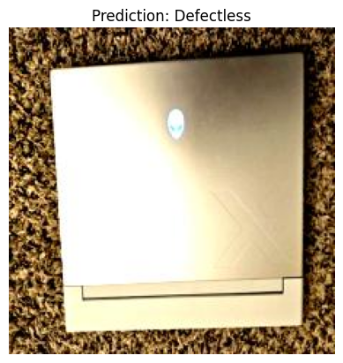
Defectless Samples

Slide 5
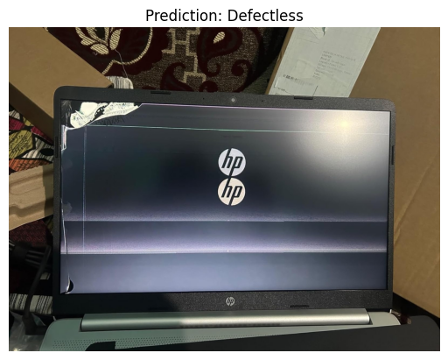
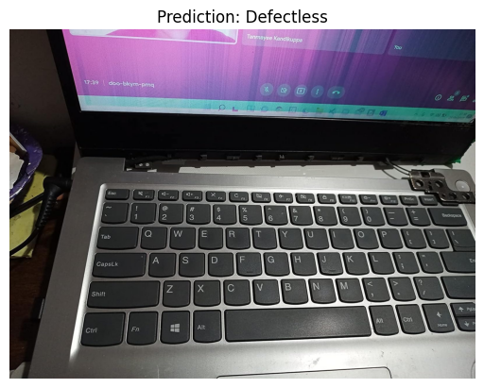
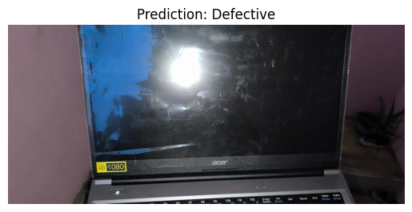
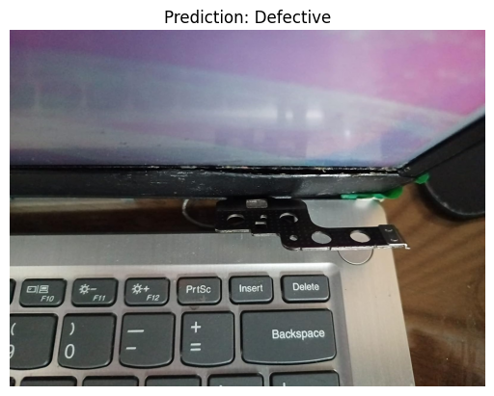
Defective Samples

Slide 6
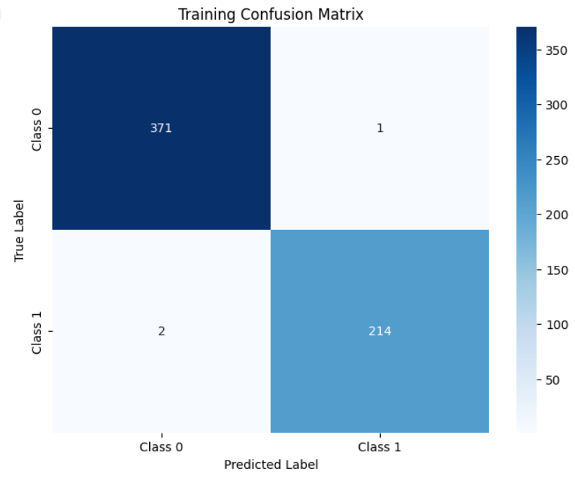
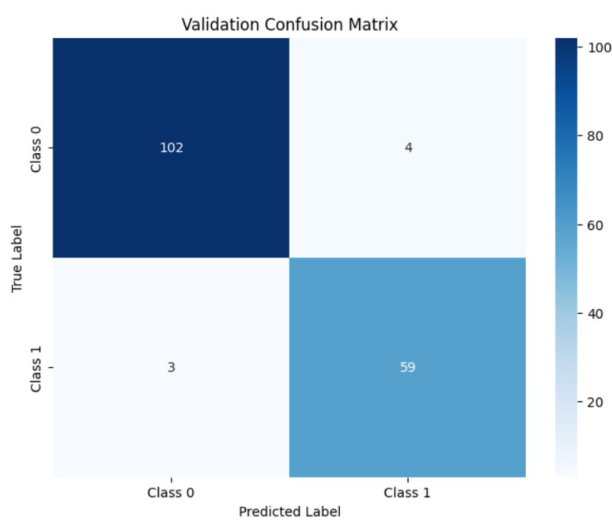
ResNet 50 - Confusion Matrix

Slide 7
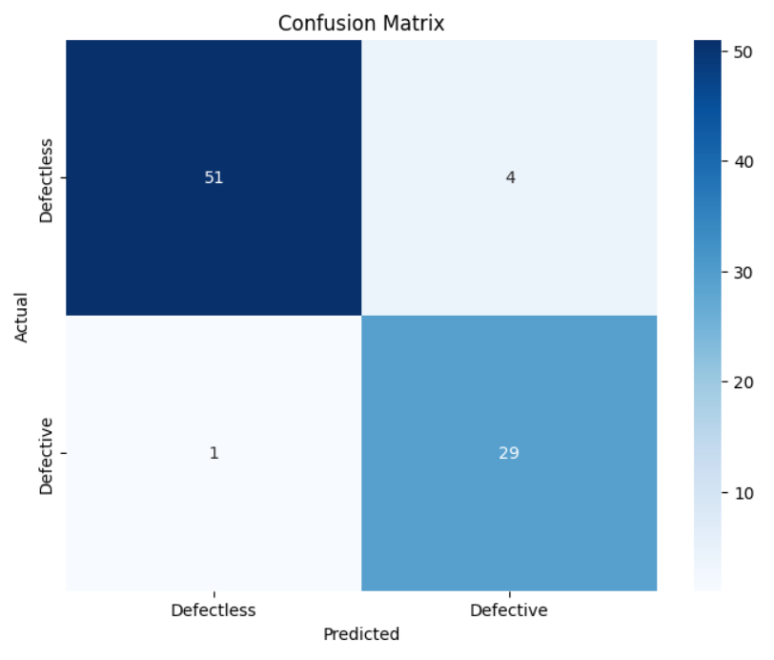
ResNet 50 - Confusion Matrix

Slide 8
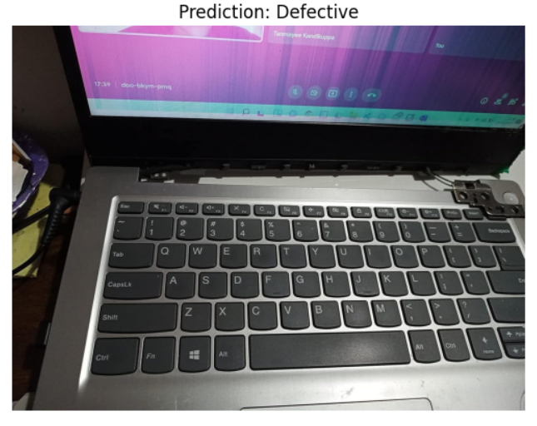
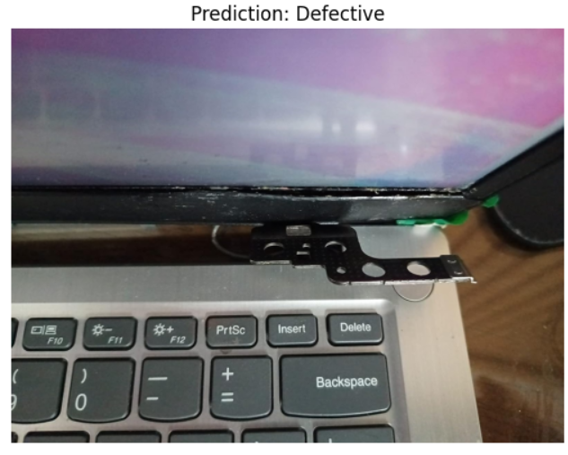
ResNet 50 - Tested on sample defect images

Slide 9
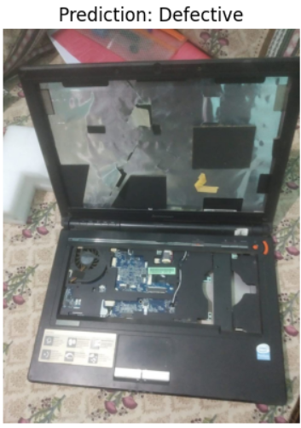
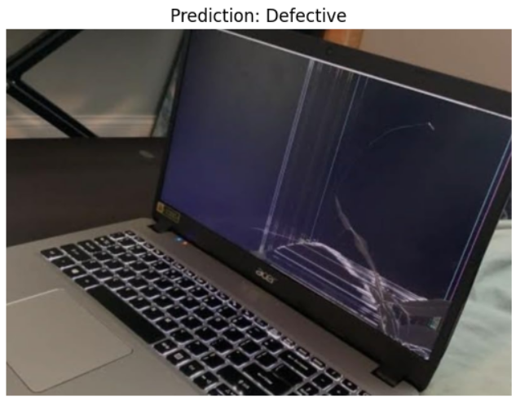
ResNet 50 - Tested on sample defect images

Slide 10
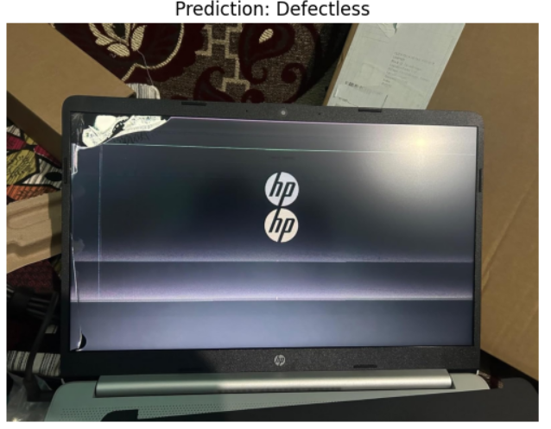
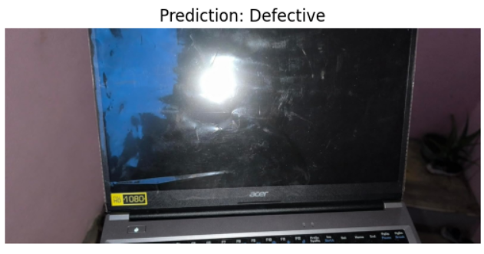
ResNet 50 - Tested on sample defect images

Slide 11
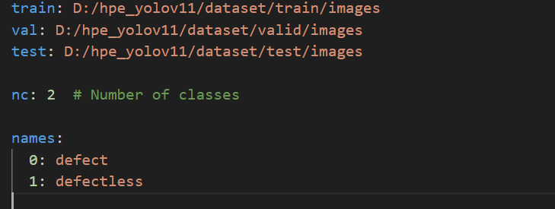
Yolov8
dataset.yaml:

Slide 12
Yolov8
dataset.yaml:

Slide 13
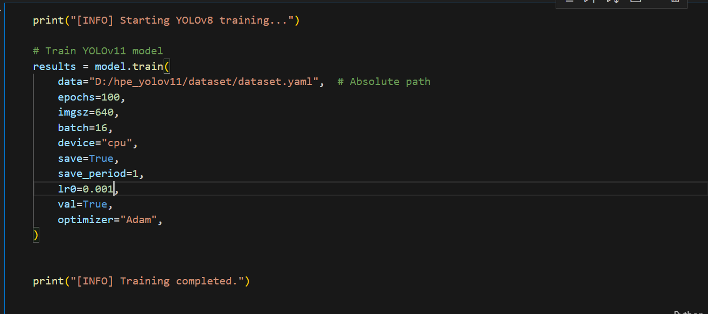
Yolov8 - First attempt of training
Training parameters:

Slide 14
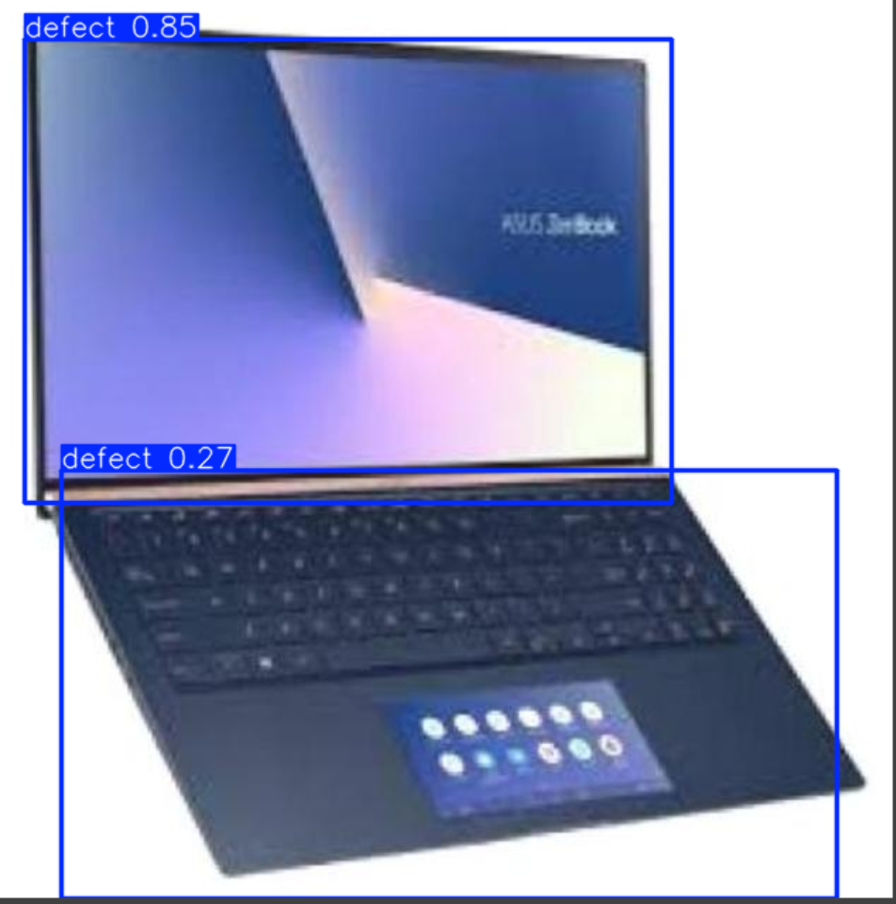
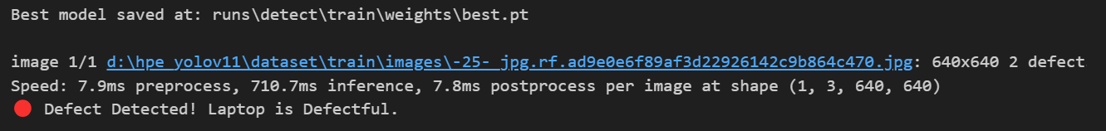
Yolov8 - Test results defectless laptops

Slide 15
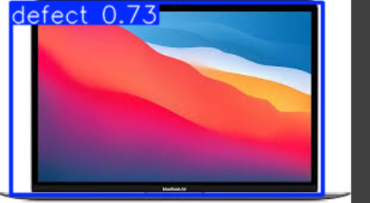
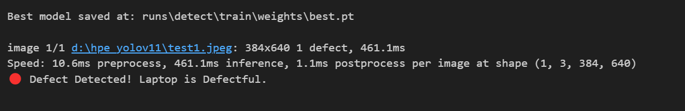
Yolov8 - Test results defectless laptops

Slide 16
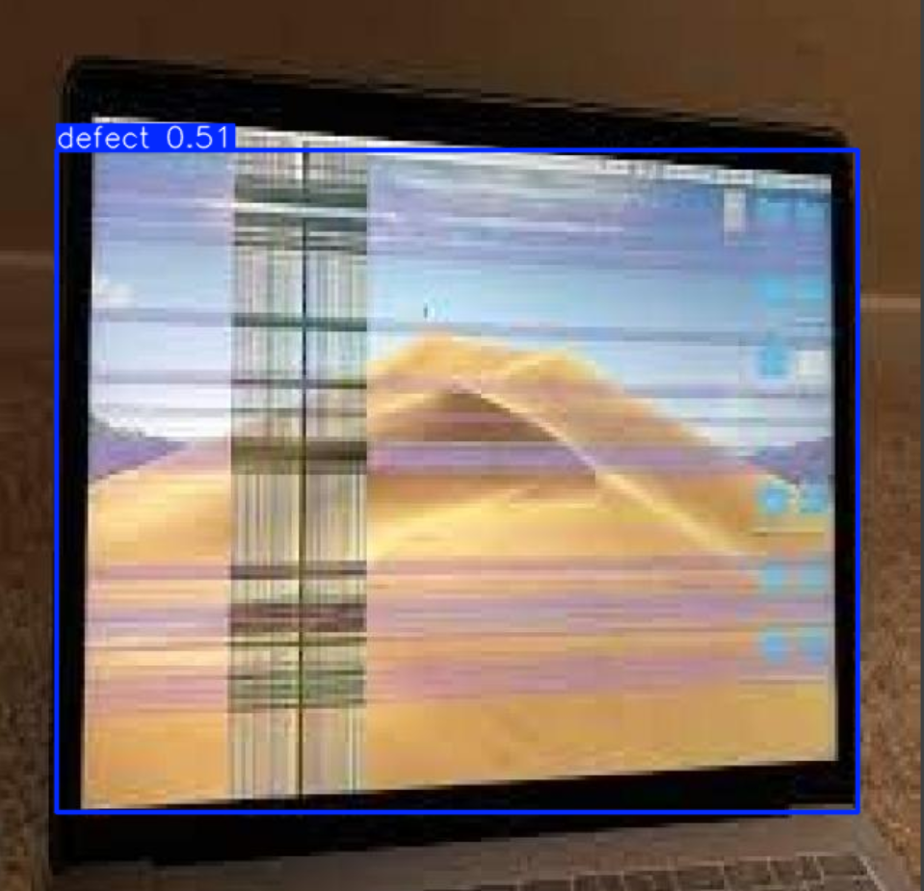
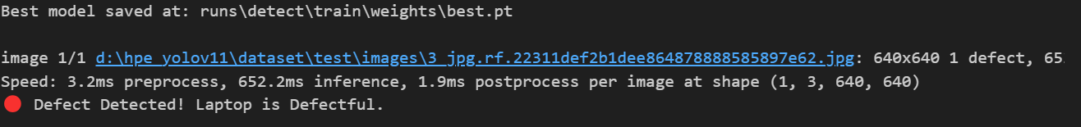
Yolov8 - Test results defectful laptops

Slide 17
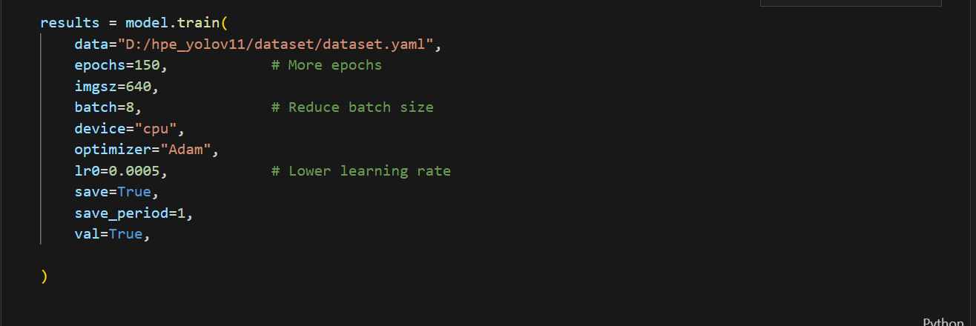
Yolov8 - Second attempt of training
Training parameters:

Slide 18
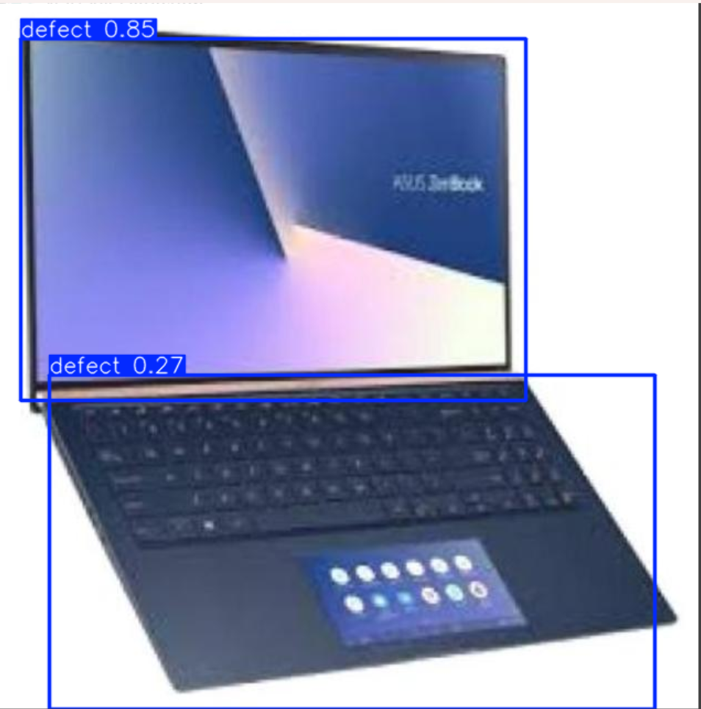
Yolov8 - Test results defectless laptops

Slide 19
Yolov8 - Test results defectless laptops

Slide 20
Yolov8 - Test results defectful laptops

